Slide 1
Project Name
User Friendly Professional Biodata Application

Slide 2
Team Details
Team Name : TECHDEVELOPERS
Team Email : techdevelopers55@gmail.com
Team Github : TECHDEVELOPERS55
Team Lead:
Name : Stalin P N
Place : Kulappuram
Qualification : BE MECH
E-mail :stalinpoulose55@gmail.com
Phone : 8760323808.
Our Team Members:
Name:A.N.Monisha
Place:Ammandivilai
Qualification:B.Sc chemistry
E-mail: moniappathurai4@gmail.com
Phone:9042539260
Task : basic detail menus creation
Name : Sreeja S,
Qualification : B.sc.horticulture,
E-mail : sreejasri95@gmail.com,
Mbl no : 7598451300,
Place : Mudavanpottai , Kothaiyar (p.o).
Name: Kavitha S
Qualification: M.A
Email: sskavitha21@gmail.com
Mbl no: 9626314573
Place:Thachamalai, Pechipparai (p.o).
Name: A.N.ANISHA
Qualification: M.Sc Mathematics
Email: appathuraianisha24@gmail.com
Mbl no: 9488210618
Place:Colachel.
Notes:
-Add team details with name and qualification,e-mail,phone no and place

Slide 3
Database Design
TB NAME personal_details
TB NAME
userdetails
DB NAME
BIO DATA
TB NAME technology_details
TB NAME
basic_detail
TB NAME experience_details
TB NAME education_details
Notes:
Get the database design from the phpmyadmin or from SRS document

Slide 4
Data base Table Design
Userdetails
id | name | username | password | email | mobileeno
basic_detail
id | user_code | name | address | email | mobile | profile | objective | declaration
education_details
id | user_code | coursename | university | college | passyear | percentage
experience_details
id | user_code | organization_name | experience | role
technology_details
id | user_code | experience_type | experience_detail
personal_details
id | user_code | personal_type | personal_detail
Notes:
Get the form design from the phpmyadmin or from SRS document

Slide 5
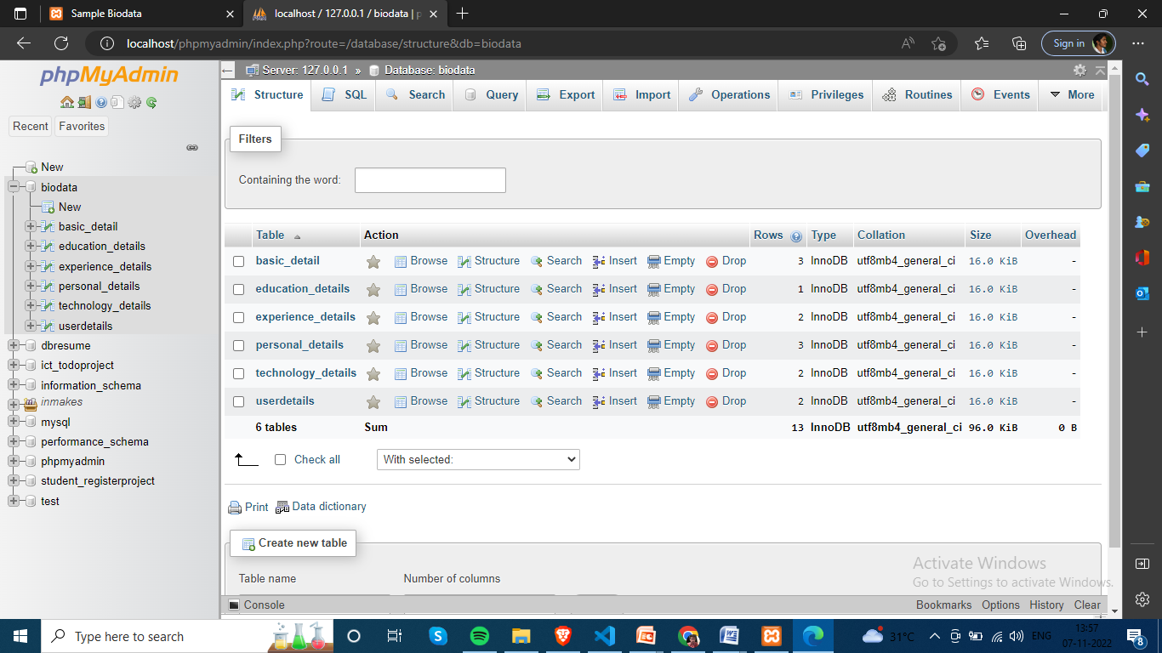
Data base Table Design

Slide 6
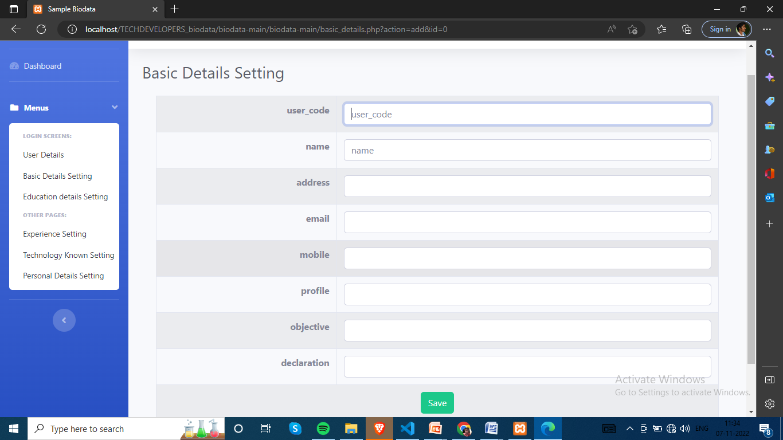
Form Design
user_code
name
address
email
mobile
profile
objective
declaration

Slide 7
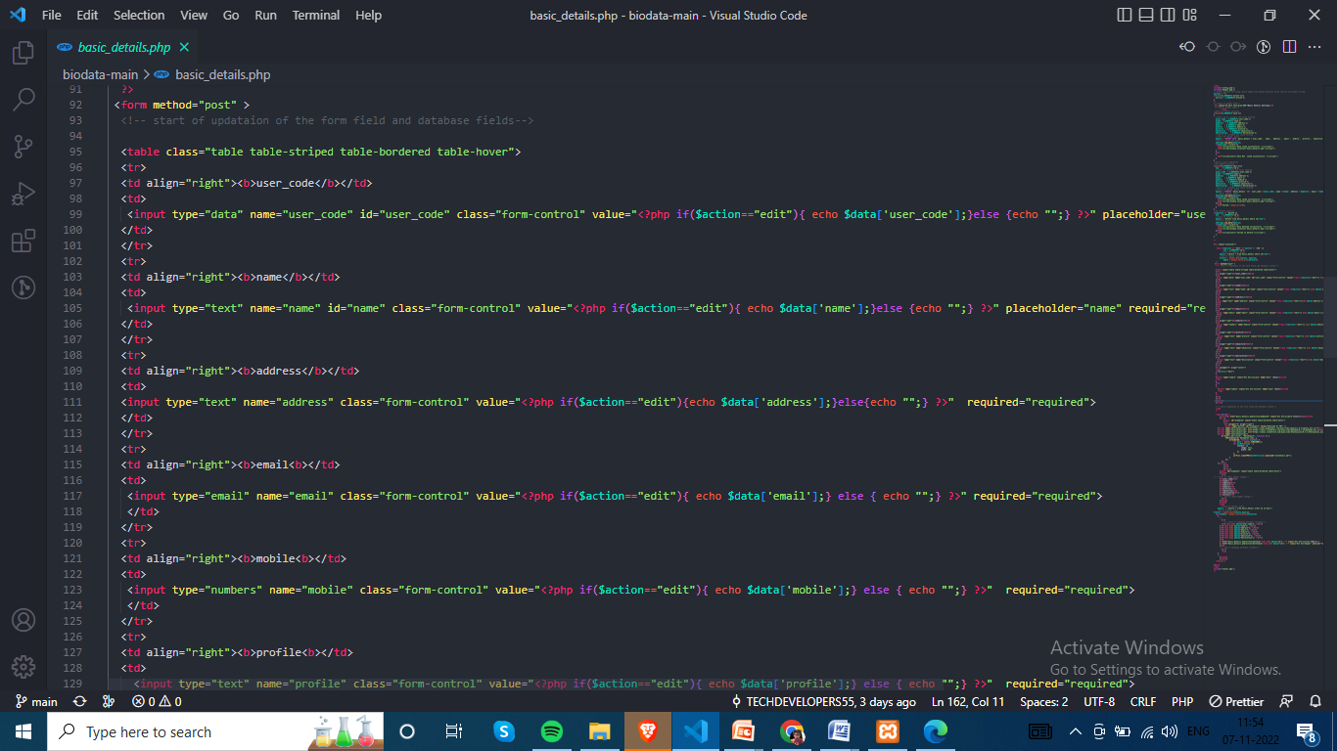
Sample Source code
Open Form tage <form method=“post”>
Open to table tag <table>
Enter the input details. SRS document based great the form details.
close table tag</table>
Close form tag</form>

Slide 8
Problem/difficulty Faced
Problems:
I used SRS documents to create the data base tables I enter the primary key for all rows that issue faced
I have used in Vs code for first time. I have edit details for source code but not saved. So run time blank page visible in browser.
Solutions:
Data base table creation first row only add primary key and auto increment options can be used
Vs code ctrl+s used to save and run the page

Slide 9
TEAM MEMBER -1

Slide 10
Forms & Database Design
Our team member 1
Php admin open and create the mysql data base Name: biodata then after i can import the db tables.
team leader assign to the SRS documents task in basic detail menus creation
I have refer the document used to create the new form in the vs code new file create and enter the source codes.
Notes:
Explain Form and database worked with

Slide 11
Problem/difficulty Faced
vs code new file creation but she open new folder .
New DB created and she can create tables and import the tables.
Notes:
Explain problem faced

Slide 12
Solution to the problem
I used to vs code and new file open and enter the source code and run the program.
Then I have Create database and import the team leader assigned DB table
Notes:
Explain how attained the solution

Slide 13
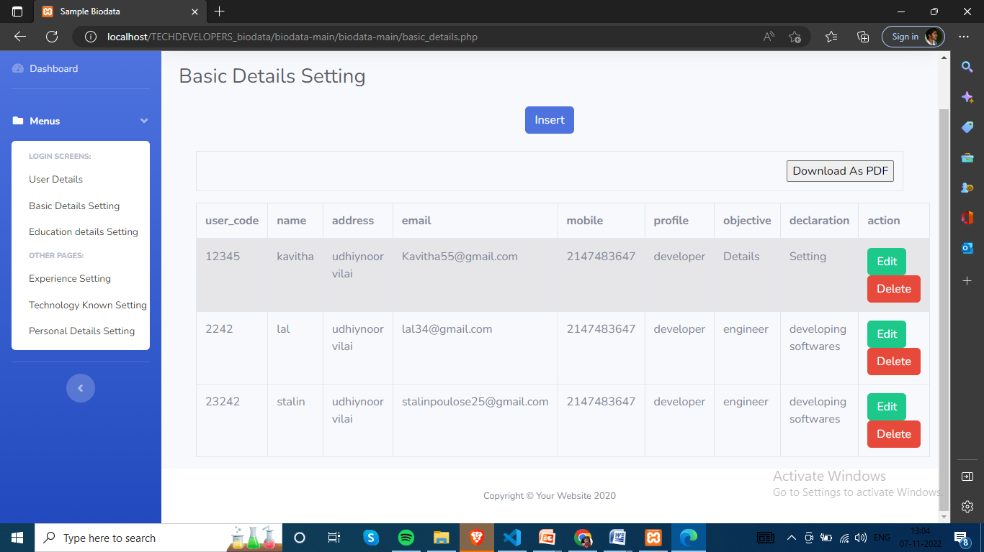
Sample Source code
Notes:
Explain how attained the solution

Slide 14
TEAM MEMBER -2

Slide 15
Forms & Database Design
Our team member 2
Php admin open and create the mysql data base Name: biodata then after i can import the db tables.
team leader assign to the SRS documents task in education details menus creation.
I have refer the document used to create the new form in the vs code new file create and enter the source codes.

Slide 16
Problem/difficulty Faced
vs code new file creation and source code enter but open page is blank.
She can edit the source codes in vs code but insert option file not saved .

Slide 17
Solution to the problem
I used to vs code and new file open and enter the source code and ctrl+s run the program.
Then I discussed to team leader he is given to the solution and i have go to database and sql insert quary can be add to vs code.

Slide 18
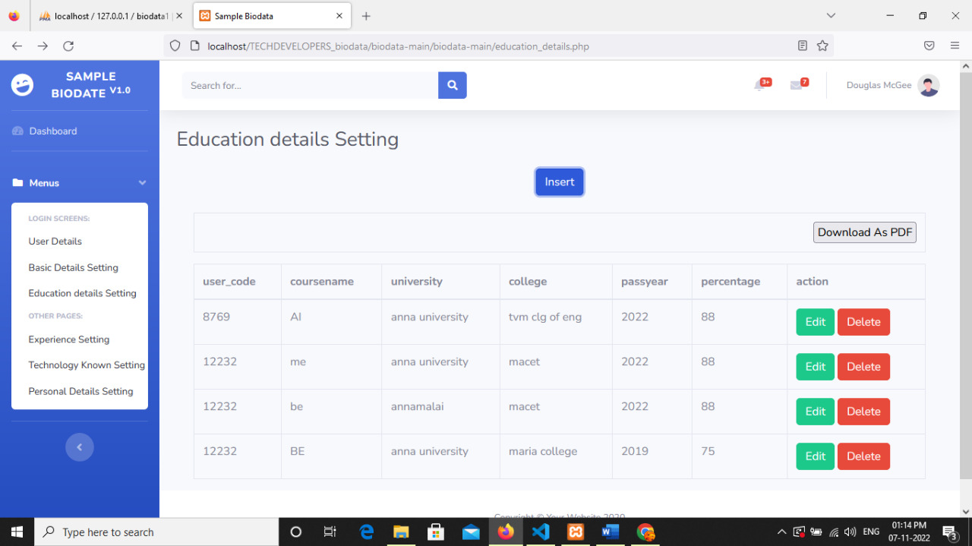
Sample Source code
Notes:
Explain how attained the solution

Slide 19
Thank You

